Slide 1
2021 Environment of Care, Life Safety Code, and Emergency Management Updates
HI Exclusive Update – May 11, 2021

Slide 2
The Joint Commission Disclaimer
These slides are current as of 3/21/2021. The Joint Commission and the original presenters reserve the right to change the content of the information, as appropriate.
These will only be available until 3/19/2022. At that point The Joint Commission reserves the right to review and retire content that is not current, has been made redundant, or has technical issues.
These slides are only meant to be cue points, which were expounded upon verbally by the original presenter and are not meant to be comprehensive statements of standards interpretation or represent all the content of the presentation. Thus, care should be exercised in interpreting Joint Commission requirements based solely on the content of these slides.
These slides are copyrighted and may not be further used, shared or distributed without permission of the original presenter and The Joint Commission.
The Joint Commission nor the presenter endorses or promotes any company’s products or services.
Notes:
2

Slide 3
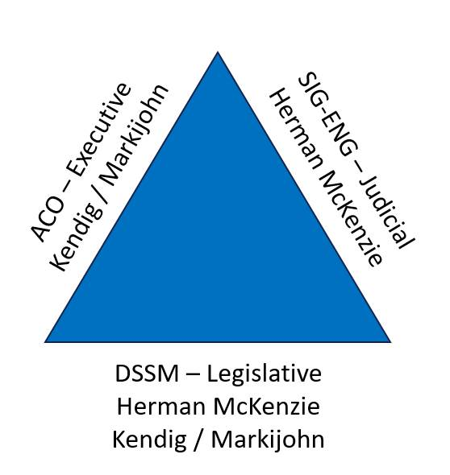

Slide 4
Jim Kendig, MS, CHSP, HEM
Field Director – Life Safety Code Surveyors

Slide 5
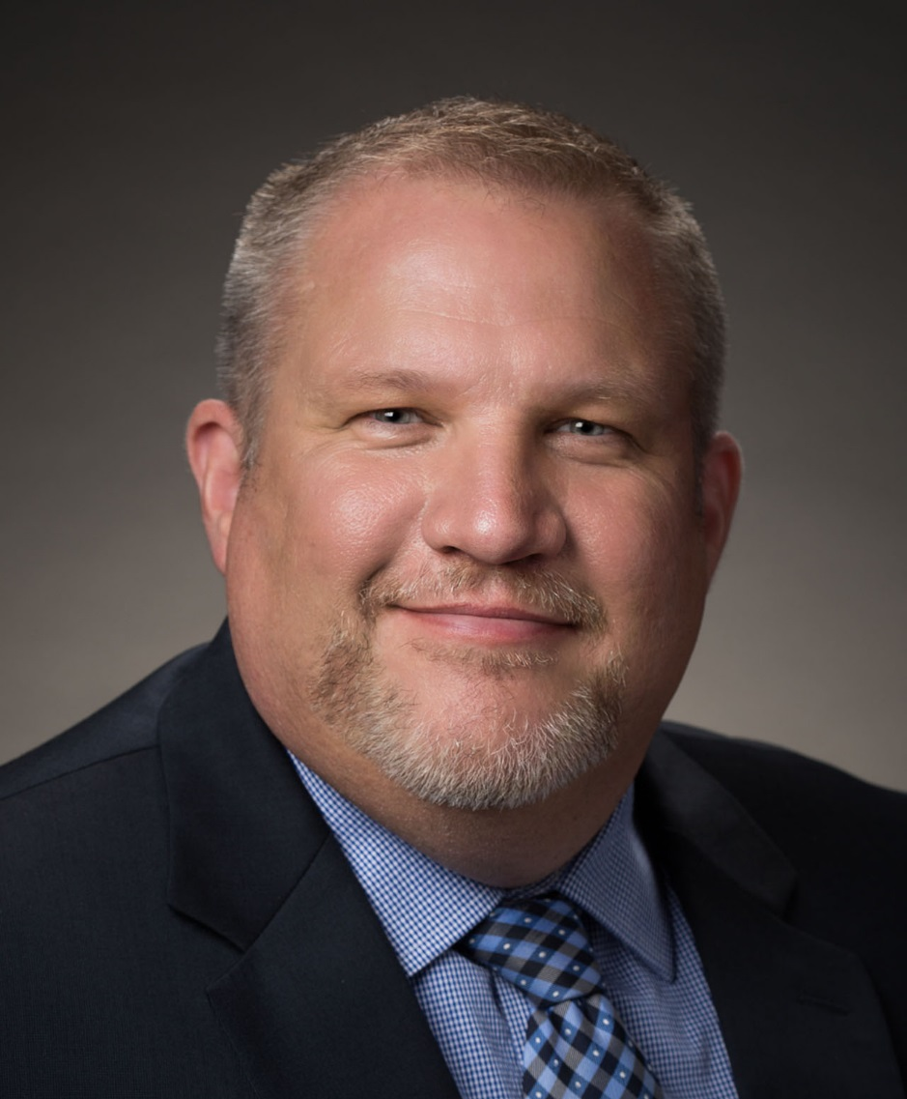
Tim Markijohn, MBA/MHA, CHFM, CHE
Field Director – Life Safety Code Surveyors

Slide 6
Herman A. McKenzie MBA, CHSP Director – Standards Interpretation Group

Slide 7
What’s New, Our Focus
Healthcare Technology Management
7

Slide 8
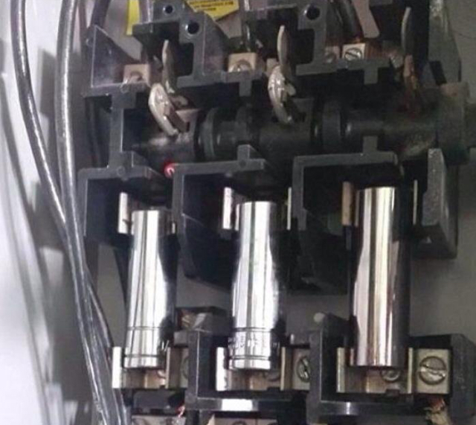
New 5000A Fuses!

Slide 9
What’s New and What We Are Working On
Return to onsite surveys 3/15/2021
NEW water management standard and EP
Retirement of the Building Maintenance Program (BMP)
New Tools
What LSCSs want you to know
New EC (2021) session and EM (proposed July 2021)
New EM standards January 2022
NEW WPV standards and Eps – July Perspectives
NEW document review checklist

Slide 10
What's New and What we are working on cont.
SAFER® Dashboard: Phase 2 Launch
Survey Process – what would you like to see?
SAFER® Dashboard will become available to all accredited organizations on April 6th, 2021.
The SAFER Dashboard is a business analytics tool that provides aggregate survey finding data and Joint Commission national comparison accreditation data. Users will be able to view and filter their cumulative survey data in meaningful ways and compare their organization(s) to Joint Commission national accreditation data.

Slide 11
What’s the Risk?
More Legionella pneumophila in the environment
More susceptible patient population
Increased awareness and testing
1 in 4 patients who acquire their infection in healthcare facility will die

Slide 12
Notes:
Heater-Coolers
Worldwide epidemic of invasive Mycobacterium chimaera

Slide 13
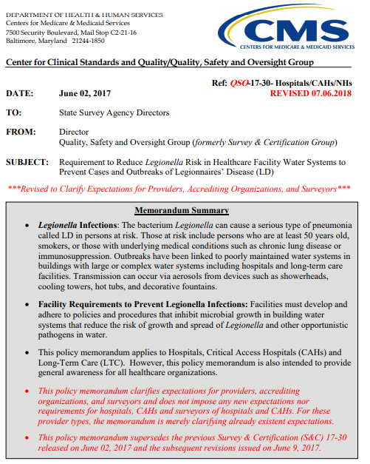

Slide 14
Where can I Find Information regarding Legionella and other opportunistic water borne pathogens?
EC News
Sept 2017 – Mitigating Legionnaires’ Disease
Feb 2019 – “A water shield against legionella
Oct 2019 – Toolbox, Preventing Legionella in Healthcare Facilities
April 2021 – New standards and EPs

Slide 15
Legionella DRAFT New standards and EPs
Standard EC.02.05.02
This standard will go into effect January 1, 2022: The organization has a water management program that addresses Legionella and other waterborne pathogens.
Note: The water management program is in accordance with law and regulation.
EC.02.05.02, EP 1
This element of performance will go into effect January 1, 2022: The water management program has an individual or team responsible for the oversight and implementation of the program, including but not limited to, development, management, and maintenance activities.
EC.02.05.02, EP 2
This element of performance will go into effect January 1, 2022: The individual or team responsible for the water management program develops the following: - A basic diagram that maps all water supply sources, treatment systems, processing steps, control measures, and end-use points Note: An example would be a flow chart with symbols showing sinks, showers, water fountains, ice machines, and so forth. - A water risk management plan based on the diagram that includes an evaluation of the physical and chemical conditions of each step of the water flow diagram to identify any areas where potentially hazardous conditions may occur (these conditions can most likely occur in areas with slow or stagnant water) Note: Refer to the Centers for Disease Control and Prevention’s “Water Infection Control Risk Assessment (WICRA) for Healthcare Settings” tool as an example for conducting a water-related risk assessment. - A plan for addressing the use of water in areas of buildings where water may have been stagnant for a period. (for example, unoccupied or temporarily closed areas) - An evaluation of the patient populations served to identify patients who are immunocompromised - Monitoring protocols and acceptable ranges for control measures Note: Hospitals should consider incorporating basic practices for water monitoring within their water management programs that include monitoring of water temperature, residual disinfectant, and pH. Additionally, protocols should include specificity around the parameters measured, locations where measurements are made, and appropriate corrective actions taken when parameters are out of range.

Slide 16
DRAFT New standards and Eps cont.
EC.02.05.02, EP 3
This element of performance will go into effect January 1, 2022: The individual or team responsible for the water management program manages the following: - Documenting results of all monitoring activities - Corrective actions and procedures to follow if a test result outside of acceptable limits is obtained, including when a probable or confirmed waterborne pathogen(s) indicates action is necessary - Documenting corrective actions taken when control limits are not maintained Note: See EC.04.01.01, EP 1 for the process of monitoring, reporting, and investigating utility system issues.
EC.02.05.02, EP 4
This element of performance will go into effect January 1, 2022: The individual or team responsible for the water management program reviews the program annually and when the following occurs: - Changes have been made to the water system that would add additional risk. - New equipment or at-risk water system(s) has been added that could generate aerosols or be a potential source for Legionella. This includes the commissioning of a new wing or building. Note 1: The Joint Commission and the Centers for Medicare & Medicaid Services (CMS) do not require culturing for Legionella or other waterborne pathogens. Testing protocols are at the discretion of the hospital unless required by law or regulation. Note 2: Refer to ASHRAE Standard 188-2018 “Legionellosis: Risk Management for Building Water Systems” and the Centers for Disease Control and Prevention Toolkit "Developing a Water Management Program to Reduce Legionella Growth and Spread in Buildings" for additional guidance on creating a water management plan. For additional guidance, consult ANSI/ASHRAE Guideline 12-2020 “Managing the Risk of Legionellosis Associated with Building Water Systems.”

Slide 17
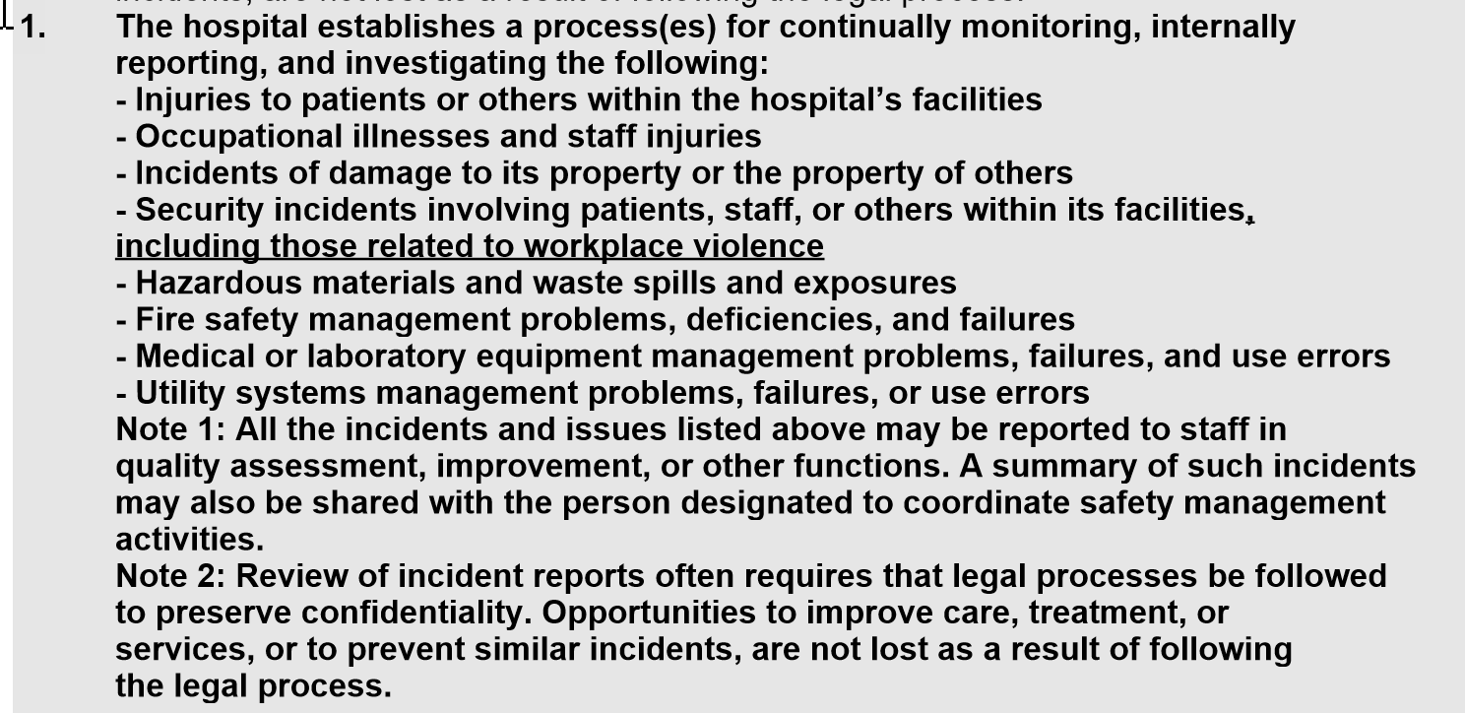
WPV Draft Standards and Eps (field review version EC, HR, and LD)

Slide 18
New tools…from LSCSs!
Healthcare Technology Management
18

Slide 19
New tools…(new HBO and OR drills required by NFPA)

Slide 20
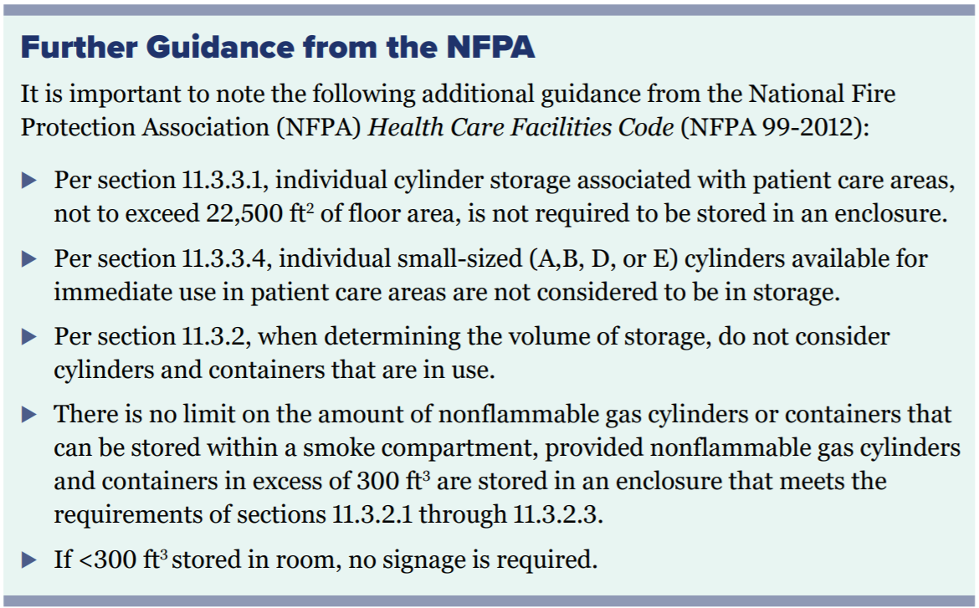
New tools cont. May 2021 EC News

Slide 21
New tools cont. Generator Battery Testing EC.02.05.07 EP-4

Slide 22
Joint Commission EC.02.03.05, EP 12 & NFPA 25, 2011
EC.02.03.05, EP12
Every 5 years the hospital/ CAH/ AHC conducts hydrostatic and waterflow tests on standpipe systems and the results are documented.
References: NFPA 25, 2011 edition
6.3.1, 6.3.2, Table 6.1.1.2
Note: NFPA 14 is for new installations only, not testing or maintenance of existing.
Per 6.3.2.2 System modified or repaired?
6.3.1:
5 year flow test required.
6.3.2:
5 year hydrostatic test required.
Classes
I = 2 ½ inch connections only
II= 1 ½ inch connections only
III= Both size connections
yes
System all automatic?
5 year 6.3.1 flow test required
Note: 6.3.2.1.1
Manual wet standpipes part of a combined sprinkler /standpipe system shall not be required to be hydro’ tested.
no
yes
5 year 6.3.1 flow test required
Hydrostatic test not required
System wet combined?
no
yes
System all manual or semi-auto dry?
no
6.3.1:
5 year flow test required.
6.3.2:
5 year hydrostatic test required.
yes

Slide 23
What Life Safety Code Surveyors want you to Know…
Healthcare Technology Management
23

Slide 24
Retirement of BMP
We are retiring the BMP in July 2021
Page LS – 3
Not adopted by CMS
Allows organizations flexibility in addressing deficiencies via there own methodology

Slide 25
Life Safety Code Surveyor Days July 2020
REMINDER: LSCS added one day for each free-standing emergency department and ambulatory surgery center.
*NOTE: Additional time for the Life Safety Code Surveyor will not be added to Department of Defense hospital organizations length of survey, but all areas identified are in scope of survey and will be addressed by the assigned clinical surveyors. This decision was made based on current contract language and is subject to change in the future.

Slide 26
What LSCSs want you to know!
Power strips not installed/used per NFPA 99: 10.2.3.6 (more later)
Double doors in suite boundaries with meeting edge gaps in excess of 1/8 inch.
Fire drills – one hour apart (looking at 4 quarters)
New fire drill matrix!
New 05 LS standards and eps
Don’t forget about the ‘kitchen checklist!’
SCAB patches! (see EC News Sept 2020)

Slide 27
Requirements Life Safety Code Surveyors Want You to Know About...

Slide 28
Requirements Life Safety Code Surveyors Want You to Know About (cont.)

Slide 29
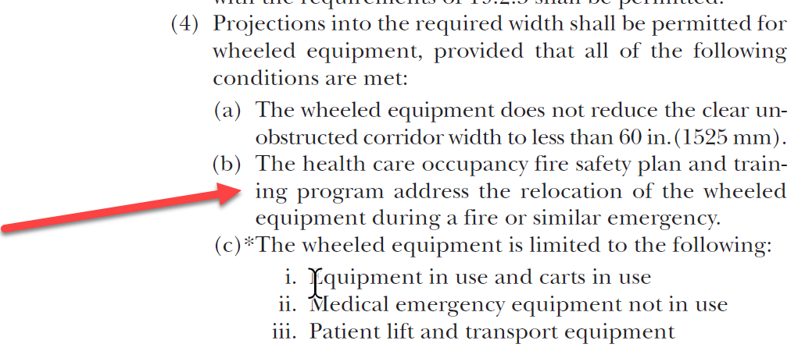
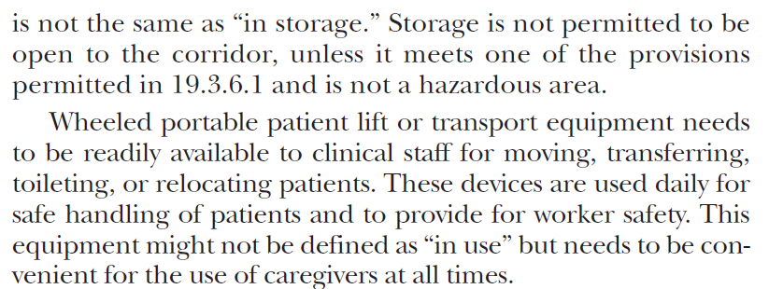
Requirements Life Safety Code Surveyors Want You to Know About (cont.) Yes…but…
What about wheeled carts in the corridor (LSC NFPA 101-2018 19.2.3.4)?

Slide 30
Condition-Level Deficiency Data – NEED TO UPDATE SLIDE
% of Hospitals with at least one Conditional-Level Deficiency (CLD) (excluding Psychiatric Hospitals)
Timeframe | Number of deemed Orgs with CLDs | % of Hospitals with at least one CLD
01/01/2020 – 12/31/2020 | 145 of 451 | 32.15%
01/01/2019 – 12/31/2019 | 439 of 1109 | 39.59%
01/01/2018 – 12/31/2018 | 532 of 1207 | 44.08%
01/01/2017 – 12/31/2017 | 544 of 1190 | 45.71%
01/01/2016 – 12/31/2016 | 386 of 1145 | 33.71%

Slide 31
Survey Process…what we’ve done and we want to hear from you!

Slide 32
LSCS Survey Process
Standardized agenda
Standardized morning of day 1 facility orientation (0800-0900)
Standardized fire drill matrix
Standardized agenda
Three Questions
Fire Stop…?
Above ceiling…?
HLD…?
Three (3) resources…

Slide 33
LSCS Survey Process
Hard stop…
Real Time Calls (RTCs)…
EC session…
EM session…
Building tour
Critical pressure relationship areas

Slide 34
Now I want to hear from you…what can we do to enhance the survey process!

Slide 35
Condition-Level Deficiency Data
% of Psychiatric Hospitals with at least one Conditional-Level Deficiency (CLD)
Timeframe | Number of deemed Orgs with CLDs | % of Hospitals with at least one CLD
01/01/2020 – 12/31/2020 | 22 of 77 | 28.57%
01/01/2019 – 12/31/2019 | 80 of 212 | 37.7%
01/01/2018 – 12/31/2018 | 78 of 187 | 41.71%
01/01/2017 – 12/31/2017 | 95 of 186 | 51.08%
01/01/2016 – 12/31/2016 | 113 of 203 | 55.67%

Slide 36
% of Hospitals with at least one Conditional-Level Deficiency (CLD) (excluding Psychiatric Hospitals)

Slide 37
Life Safety Code Surveyors Average RFI’s per Survey Full Hospital Surveys
2020
14.01
2019 | 2018 | 2017 | 2016 | 2015 | 2014
17.04 | 16.33 | 13.13 | 10.96 | 11.17 | 10.52
COVID
SAFER & “See it / Cite it”
“C” Category & OFI’s

Slide 38
U.S. Most scored during surveys…1/1/20 to present

Slide 39
Most scored during HI surveys...1/1/20 to present

Slide 40
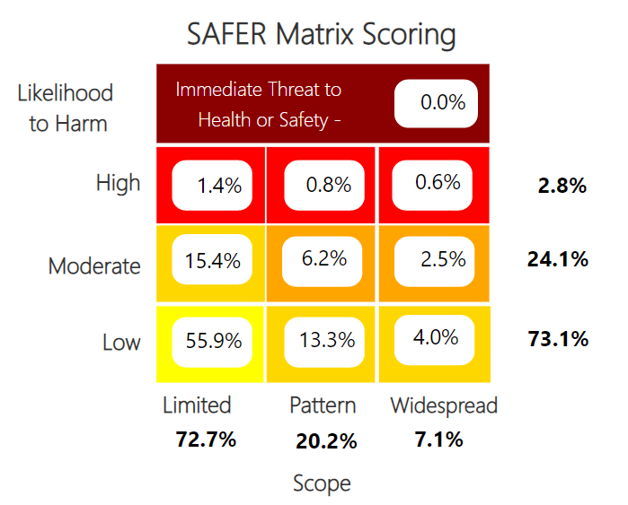
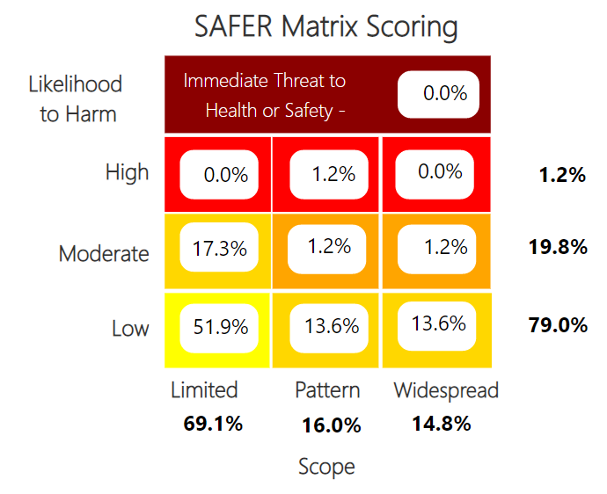
SAFER comparison
USA
HI

Slide 41
Some conclusions…
SAFER
Nothing in ITH – congrats!
Consistent in placement!
All EC standards and elements of performance!
Scoring
Let’s take a deeper dive…

Slide 42
US v HI
Top 5 – US
EC 2 6 1 – 1 (catch all…)
LS 2 1 35 – 4 (stuff on/affixed)
EC 2 5 5 - 6 (non high- risk utilities)
LS 2 1 35 – 14 (catch all)
EC 2 2 1 – 5 (haz matls)
Top 5 – HI
EC 2 5 7 – 5 (weekly inspection EPSS)
EC 2 3 5 – 28 (NFPA/Year)
EC 2 5 5 – 4 (High risk utility inventory)
EC 2 5 9 – 11 (valves labeling)
EC 2 6 1 EP 1 (catch all)
ALL EC!

Slide 43
Common Compliance Questions
Regarding the Public Health Emergency (PHE)
43

Slide 44
PHE Compliance Issues
Question - If rooms are repurposed from neutral to negative or positive to negative due to the current pandemic, should we still let the Joint Commission know prior to survey would the survey than be postponed

Slide 45
PHE Compliance Issues
Answer – Per QSO 2031 update issued 1/4/2021
According to the CMS "COVID-19 Emergency Declaration Blanket Waivers for Health Care Providers", blanket waivers are in effect with a retroactive effective dated of March 1, 2020 through the end of the emergency declaration (ED). As such, the extent of ITM and associated corrective actions performed is at the discretion of the facility during the ED and ITM deficiencies are not to be cited during the ED. CMS has not issued guidance on ITM requirements post-PHE.

Slide 46
PHE Compliance Issues
Question - How many air circulations for a room that doesn't have negative pressure?

Slide 47
PHE Compliance Issues
Answer - The amount of air changes will depend upon the space in question. There is no way to list them in this presentation. In addition to minimum air changes per hour (ACH) some spaces require minimum outdoor air changes per hour. You should reference the ASHRAE 170 2008 ventilation table for the specifics. In addition, your organization should be conducting period air balance testing to verify that all spaces are compliant.

Slide 48
PHE Compliance Issues
Question- Will extension of time be granted for Ligature Risk Extension Request due to manufacture shut down during COVID-19 and difficulty obtaining hardware?

Slide 49
PHE Compliance Issues
Answer - Organizations that have difficulty obtaining resources which will cause a delay in completing corrective actions can request additional time. This should be done as part of your monthly update.

Slide 50
PHE Compliance Issues
Question - Please provide information regarding using the pandemic as one of the emergency management drills. I believe that there are six topic that must be addressed.

Slide 51
PHE Compliance Issues
Answer - Documentation should be broken down into the six critical areas:
Communication – what worked well and what did not
Resources and assets – what was abundant, adequate, lacking
Safety and security – what issues arose and how resolved
Staff responsibilities - what issues arose and how resolved
Utilities - what issues arose and how resolved
Patient clinical and support activities - what was abundant, adequate, lacking

Slide 53
Jim Kendig, MS, CHSP, HEM
Field Director
jkendig@jointcommission.org
(630) 792-5819
Tim Markijohn, MBA\MHA, CHFM, CHE
Field Director
tmarkijohn@jointcommission.org
(630) 792-5148
Herman A. McKenzie, MBA, CHSP
Director – Standards Interpretation Group
hmckenzie@jointcommission.org
(630) 792-5718

